Slide 1
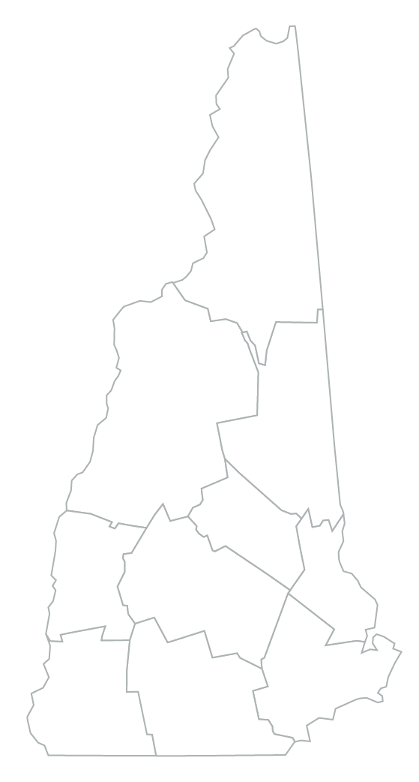
Community Data Profile
Name of County
Social & Economic Factors
Demographic Snapshot
ABC County || New Hampshire
ABC County || New Hampshire
Ethnicity & Race
$XXXXX || $XXXXX median household income
XX% || XX% children in poverty
XX% || XX% unemployment rate
Population: ##### || #######
XX% || XX% children in single-parent households
XX% || XX% households with food insecurity
XX% || XX% households with severe housing problems
XX% || XX% persons under 5 years old
XX% || XX% persons under 18 years old
XX% || XX% persons 65 years and older
Community Health & Safety
## || ##
## || ##
## || ##
## || ##
## || ##
## || ##
XX% || XX%
ABC County || New Hampshire
excessive drinking
opioid-related ED visits (per 100K)
fatal overdoses (per 100K)
suicides (per 100K)
violent crime (per 100K)
substantiated child abuse cases (per 1K)
youth in foster care (per 1K)
Notes:
*** INSTRUCTIONS: Move the star on the map to the location of your county ***

Slide 2
Indicator Name | Year | Link to Data Source
Population |  | https://www.census.gov/quickfacts/NH
Ethnicity & Race |  | https://www.census.gov/quickfacts/NH
Persons under 5 years old |  | https://www.census.gov/quickfacts/NH
Persons under 18 years old |  | https://www.census.gov/quickfacts/NH
Persons 65 years and older |  | https://www.census.gov/quickfacts/NH
Median household income |  | https://www.census.gov/quickfacts/NH
Children in poverty |  | https://www.countyhealthrankings.org/app/new-hampshire/2022/compare/snapshot
Unemployment rate |  | https://www.nhes.nh.gov/elmi/statistics/documents/laus-current.pdf
Children in single-parent households |  | https://www.countyhealthrankings.org/app/new-hampshire/2022/compare/snapshot
Households with food insecurity |  | http://map.feedingamerica.org/county/2020/overall/new-hampshire/
Households with severe housing problems |  | https://www.countyhealthrankings.org/app/new-hampshire/2022/compare/snapshot
Excessive drinking |  | https://www.countyhealthrankings.org/app/new-hampshire/2022/compare/snapshot
Opioid-related ED visits (per 100K) |  | https://www.dhhs.nh.gov/wisdom/dashboard.html?topic=opioid-misuse&subtopic=misuse-hospitalizations-and-deaths&indicator=opioid-related-hospital-visits-(emergency-dept.)
Fatal overdoses (per 100K) |  | https://www.dhhs.nh.gov/wisdom/dashboard.html&topic=opioid-misuse&subtopic=misuse-hospitalizations-and-deaths&indicator=all-drug-overdose-deaths-involving-opioids
Suicides (per 100K) |  | https://www.countyhealthrankings.org/app/new-hampshire/2022/compare/snapshot
Violent crime (per 100K) |  | https://www.countyhealthrankings.org/app/new-hampshire/2022/compare/snapshot
Substantiated child abuse cases (per 1K) |  | https://datacenter.kidscount.org/data/tables/5849-substantiated-child-maltreatment-victims?loc=31&loct=5#detailed/5/4430-4439/false/870,36/any/17520,12459
Youth in foster care (per 1K) |  | https://datacenter.kidscount.org/data/tables/5854-children-in-out-of-home-placements?loc=31&loct=5#detailed/5/4430-4439/false/870,869/any/12464,17527

